Slide 2
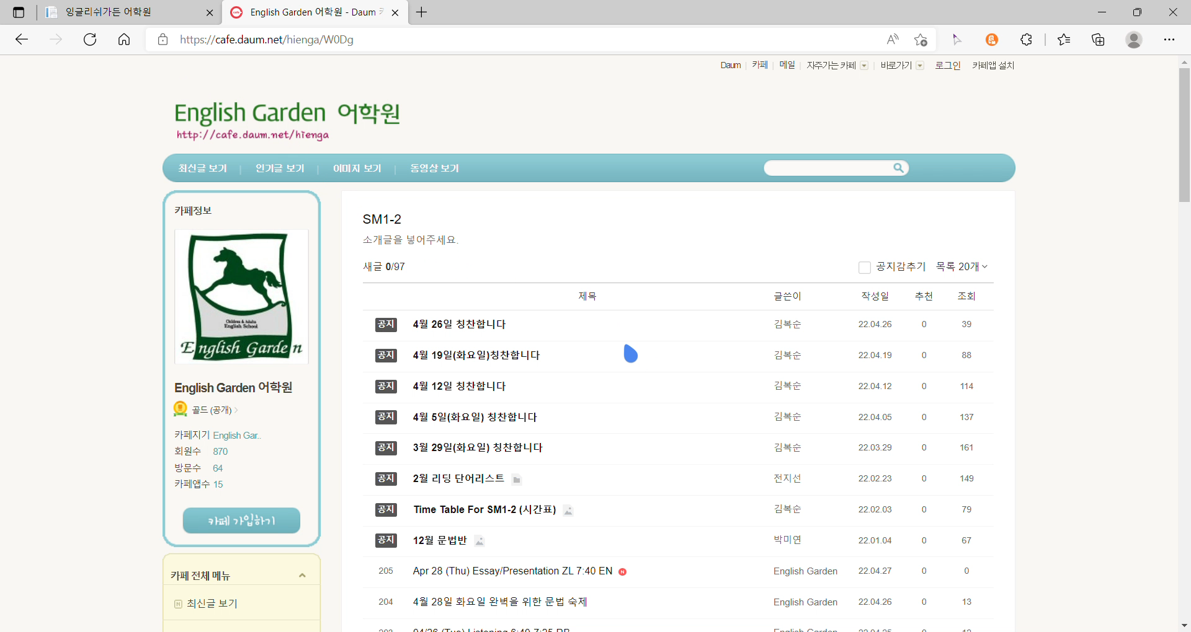
SM1-2

Slide 4
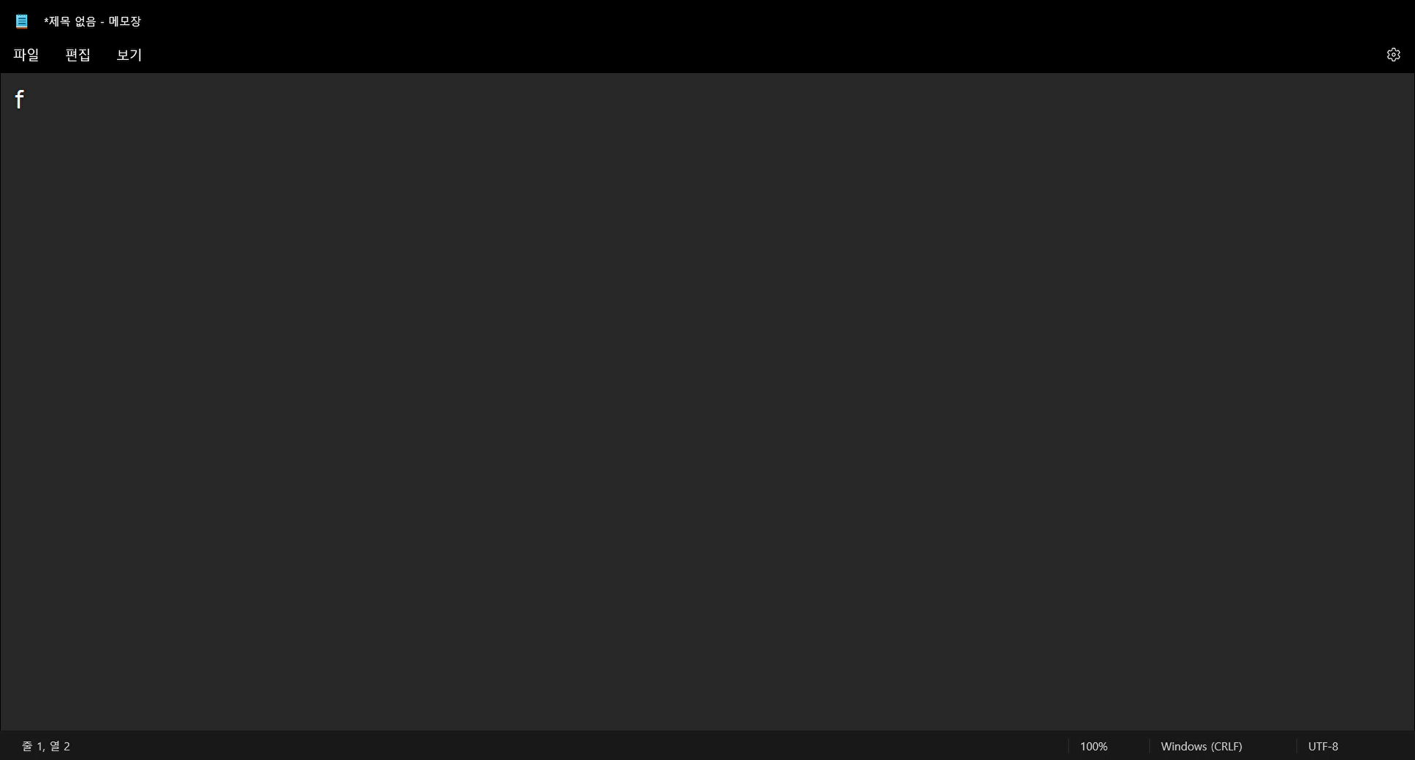
Information essay
Information essay

Slide 6
POWERPOINT

Slide 7
PPT
: Foreign language, the best fantasy of learning

Slide 9
Introduction

Slide 10
Introduction

Slide 11

Introduction
A
가
あ
Today, many people learn foreign languages

Slide 12
Introduction
A
가
あ
But I don't agree with this

Slide 13

Introduction
So I'll explain why I don't agree with this opinion in the after.

Slide 14
The first reason
Why learn a foreign language?

Slide 15
The first reason
Do we really need a foreign language when we learn it at school or academy? Let's think about it. If you don't learn a foreign language in this world, people who learn a foreign language will be better off in society. Then, they teach foreign languages at academies and schools. Then if the person who learned two foreign languages lives better in society... This could be a language school, not a school. Why is it like this? The reason is the academic nature of language. Mathematics, science, history, all studies go through this. However, language seems to be perfectly understood by the presence of foreigners. Therefore, foreign languages don't have to be perfect. Even if it's a world language.

Slide 16
The second reason
the benefits of learning a foreign language

Slide 17

The second reason
알 수 없는 작성자 님의 이 사진에는 CC BY-NC 라이선스가 적용됩니다.

Slide 18
The third reason
Is a foreign language a study?

Slide 19
The third reason
알 수 없는 작성자 님의 이 사진에는 CC BY-NC 라이선스가 적용됩니다.

Slide 20
Thank you for listening

